Slide 1
ECE 313: PROBABILITY WITH ENGINEERING APPLICATIONS
Fall 2023
Prof. Eric Chitambar
Lecture 4

Slide 2


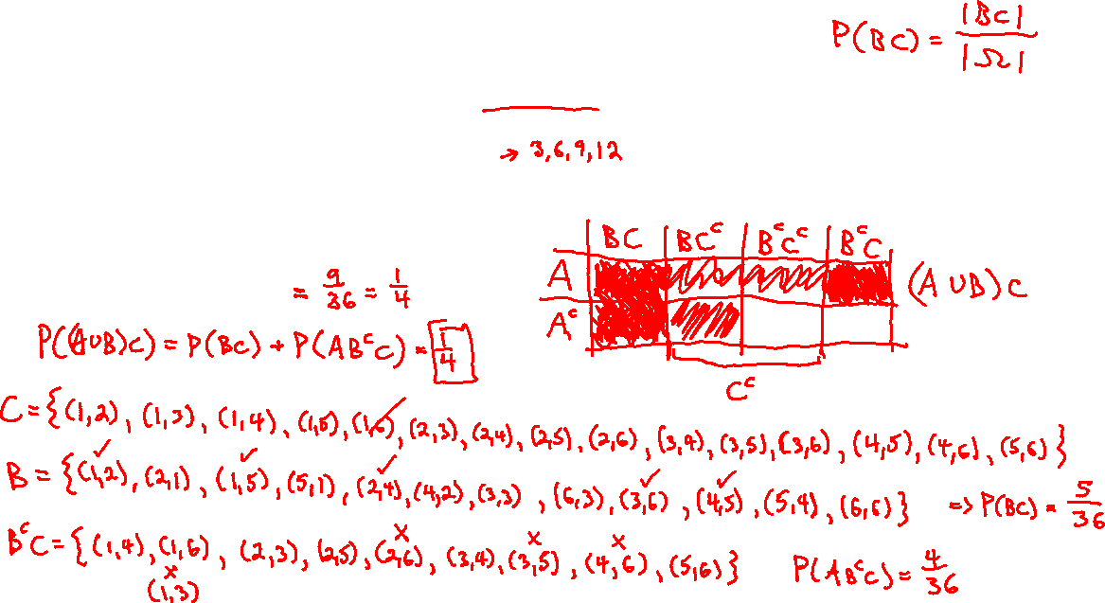
A Karnaugh map for three events

Slide 3
A Karnaugh map for three events

Slide 4

Sample spaces of infinite cardinality

Slide 5

Countably Infinite Sets

Slide 6

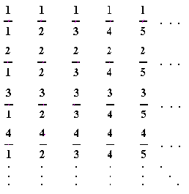









Countably Infinite Sets

Slide 7
Uncountably Infinite Sets

Slide 8




Countably Infinite Sets

Slide 9










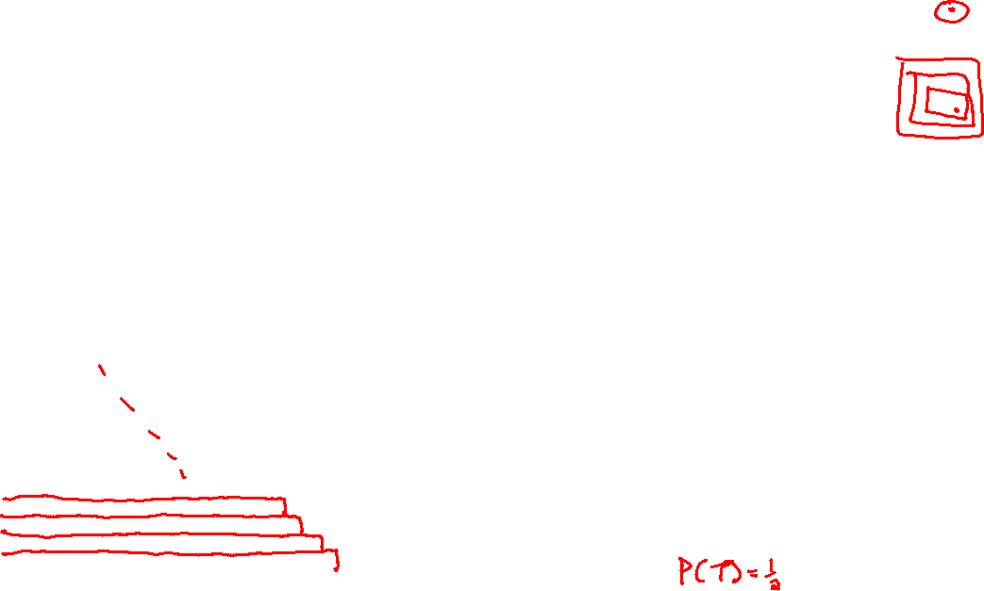
Uncountably Infinite Sets

Slide 10


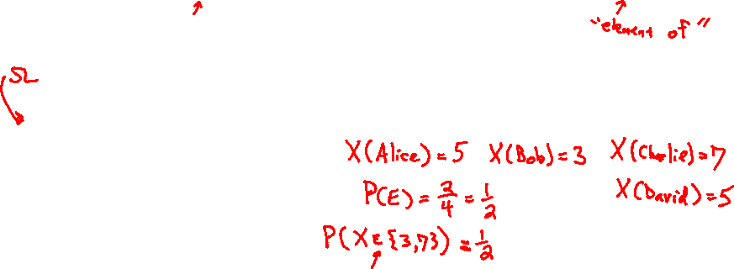
Random Variables

Slide 11


Random Variables

Slide 12




Random Variables

Slide 13
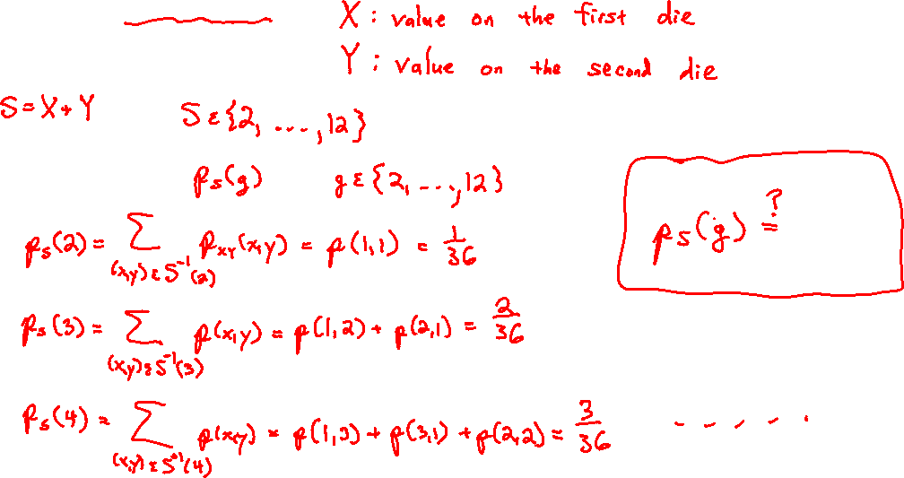
Random Variables

Slide 14

Mean of a Random Variable

Slide 15
Mean of a Random Variable

